Slide 1
Austin Community College
Phi Theta Kappa
College Prep
Mr. Gordon
jgordon@bisdtx.org

Slide 2
Upcoming Events
Monday, Sept. 6th Labor Day Holiday for CRCA and ACC
Tuesday, Sept. 7th CRCA Holiday, 10th and 12th still have ACC
Thurs. Sept. 16th Virtual 10th Grade Parent Meeting
Tues. Sept. 21st Virtual 11th Grade Parent Meeting
Friday, Sept. 17th Student Council Elections
*Officer applications are due by Friday, Sept. 3rd*

Slide 3
Phi Theta Kappa
This week, some CRCA Juniors received an invite in their ACC email or a flyer at their home address informing them about Phi Theta Kappa and encouraging them to apply.
This is an overview of Phi Theta Kappa.

Slide 4
What is Phi Theta Kappa?
“Phi Theta Kappa is the only nationally recognized International Honor Society of the Two-Year College. Alpha Gamma Pi is the local chapter at Austin Community College. Alpha Gamma Pi recognizes and promotes scholarship, the development of leadership and service, and the cultivation of fellowship among students at ACC.”
https://sites.austincc.edu/honors/phi-theta-kappa-honor-society/

Slide 5

What Does That Mean?
In simpler terms, Phi Theta Kappa is a national honor society and
Alpha Gamma Pi is ACC’s local branch.
Phi Theta Kappa is the community college version
of CRCA’s NHS.

Slide 6
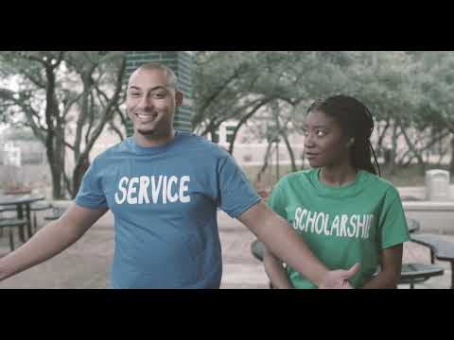
Alpha Gamma Pi
Orientation Video

Slide 7
What qualifies me for
Phi Theta Kappa?
Must be enrolled in a degree program
Must be currently enrolled in at least 6 semester credit hours
Must have minimum hours completed at ACC,
with corresponding GPA requirements:
12-23 hours completed at ACC with a minimum GPA of 3.5 (or)
24-45 hours completed at ACC with a minimum GPA of 3.4 (or)
46+ hours completed at ACC with a minimum GPA of 3.25

Slide 8
Prospective Members
Membership dues are a one time $60 fee.
Phi Theta Kappa Membership application is here:
https://docs.google.com/forms/d/e/1FAIpQLSd8PO_kOLTRGG4ZgFW7a19XlyTX91URGl76FFYjiHQ0kNI0Wg/viewform
Membership benefits can be found here:
http://sites.austincc.edu/ptk/benefits-of-membership/

Slide 9
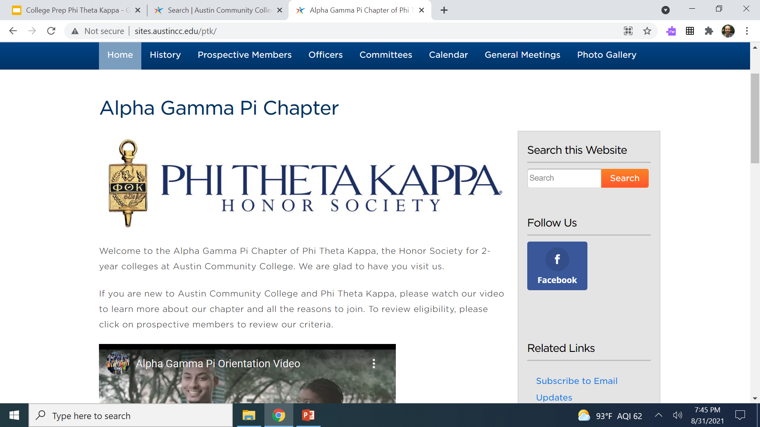
Prospective Members
New Member Orientations are held at the beginning of every Fall and Spring semester.
For more information or questions, please ask Mr. Gordon or go to http://sites.austincc.edu/ptk/

Slide 10
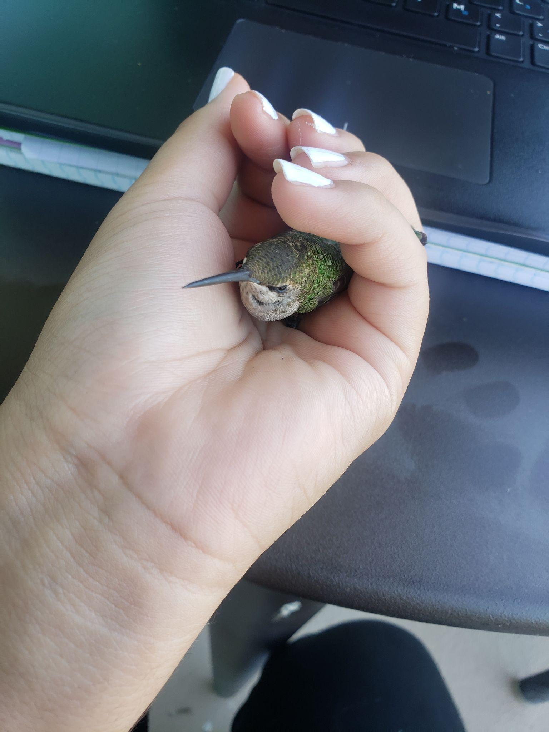
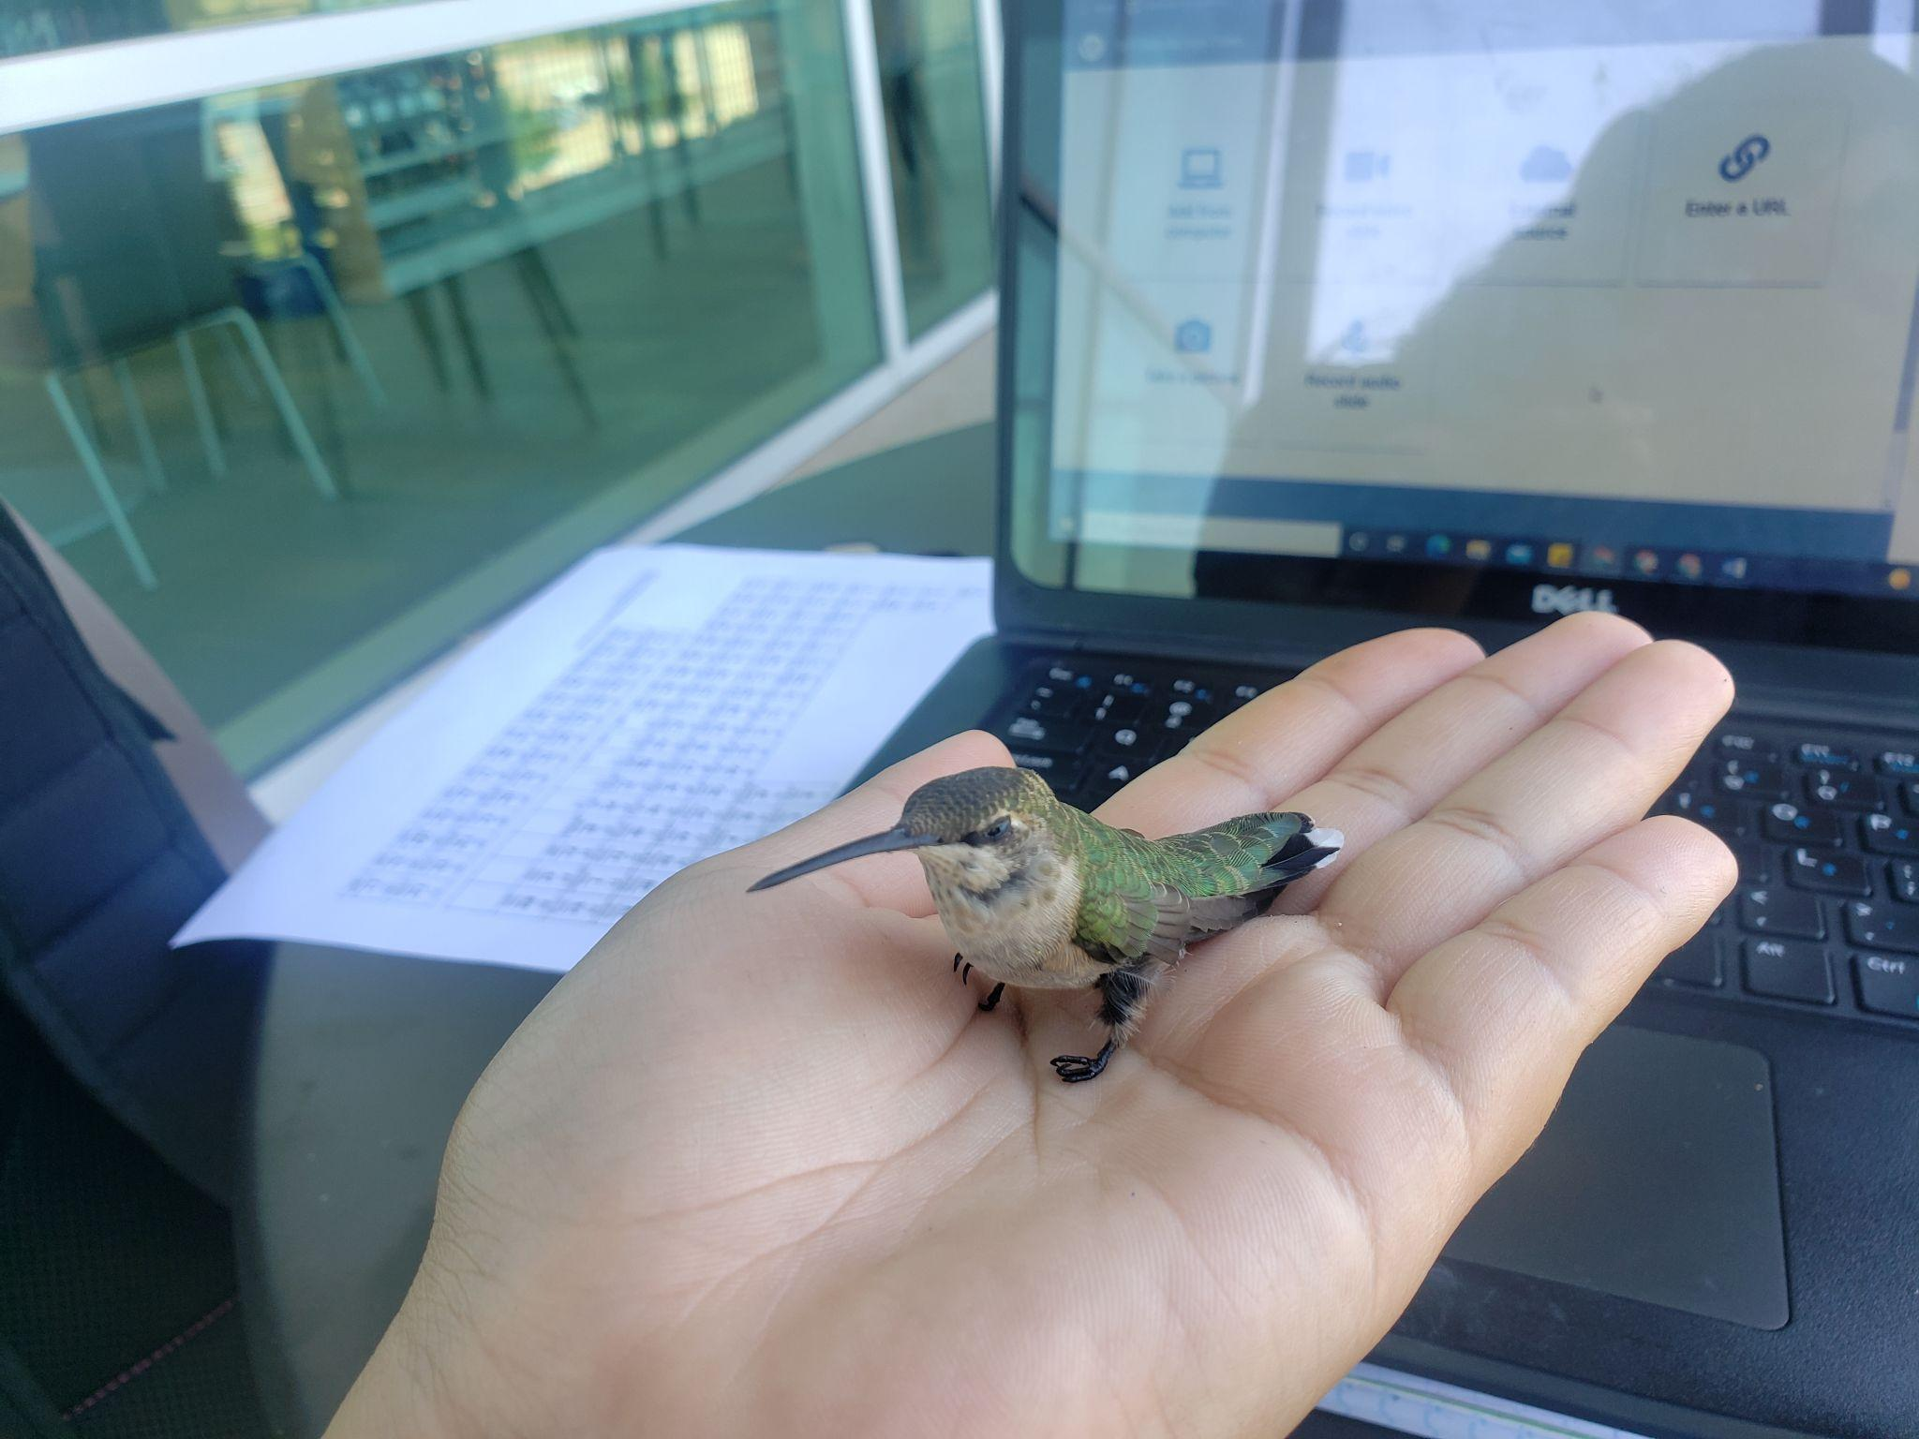
Today’s College Prep Assignment
In the comments section of today’s College Prep, name one hallmark or benefit of Phi Theta Kappa.
Hummingbird saved at ACC after flying into the library window.

